Slide 1




Let’s Find Out about PostGIS
Julinar (Backend Engineer)

Slide 2
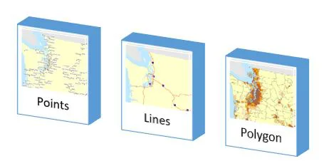
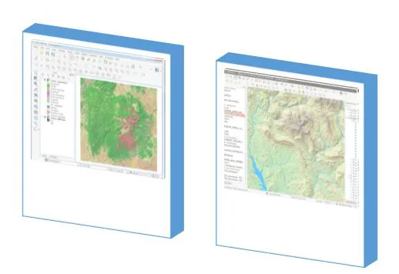
Spatial Data Type
Vector Data
Raster Data
Spatial data is any type of data that directly or indirectly references a specific geographical area or location. For example: latitude and longitude.
https://www.educba.com/what-is-spatial-data/

Slide 3


Hmm, what is it?
PostGIS is an open source Postgres extension for spatial data types.
It add spatial functions such as distance, area, union, intersection, and specialty geometry data types to PostgreSQL.

Slide 4
PostGIS Features
1
Spatial Data Storage
2
Spatial Indexing
3
Spatial Functions
4
Geometry Processing
5
Raster Data Support
6
Geocoding and Reverse Geocoding
7
Integration with several third parties

Slide 5


How to try this things?
“Make sure you already have access using PostgreSQL”
Pull postgis image:
docker pull postgis/postgis:15-3.3
Run container:
docker run --name learn-postgis -e POSTGRES_PASSWORD=postgres -e POSTGRES_USER=postgres -p 5432:5432 -d postgis/postgis:15-3.3
Execute this query to move postgis into different schema
UPDATE pg_extension SET extrelocatable = true WHERE extname = 'postgis';
ALTER EXTENSION postgis SET SCHEMA app;
https://github.com/postgis/docker-postgis

Slide 6
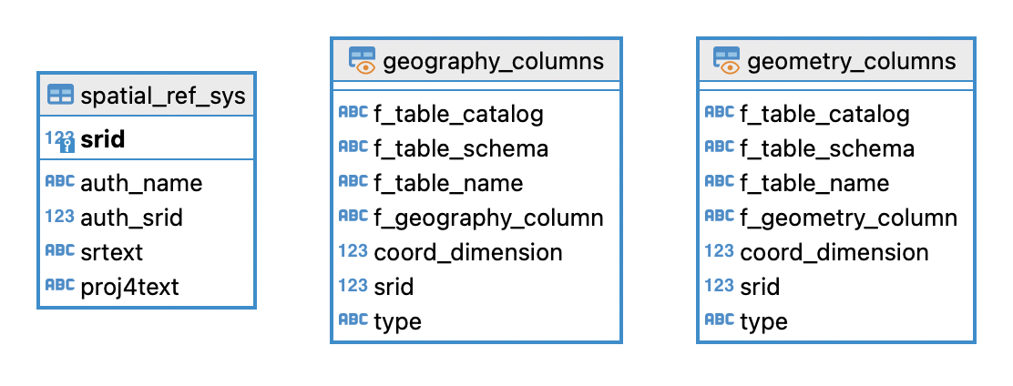
Database side
Connect to your database (PostgreSQL) with super-user account.
Add PostGIS extension into your database, execute this query:
CREATE EXTENSION postgis SCHEMA app;
Then, it will automatically generate 3 new tables
Notes:
A spatial reference identifier (SRID) is a unique identifier associated with a specific coordinate system, tolerance, and resolution. There are various recognized standard SRIDs, such as those defined by the European Petroleum Survey Group (EPSG). The SRID is used to tell which spatial reference system will be used to interpret each spatial object. A common SRID in use is 4326, which represents spatial data using longitude and latitude coordinates on the Earth's surface as defined in the WGS84 standard, which is also used for the Global Positioning System (GPS). When setting a shape's SRID, you can only use SRIDs that are defined in the spatial_ref_sys table.

Slide 7
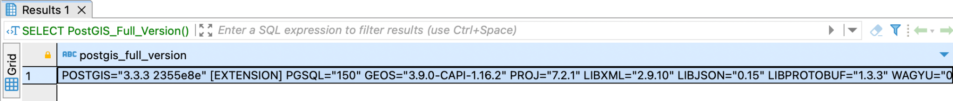
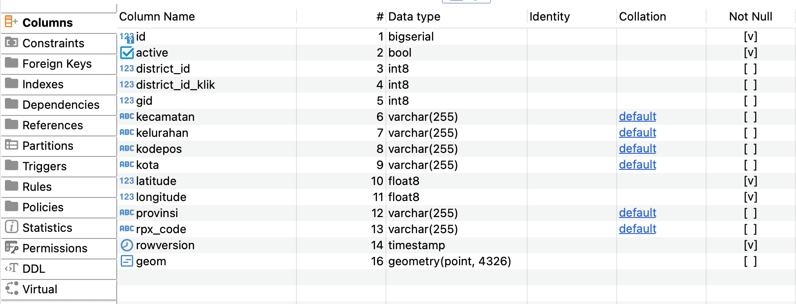
3. Make sure PostGIS already installed with execute this query
SELECT PostGIS_Full_Version();
4. Add geometry column into table that has spatial data type.
ALTER TABLE coverage_area ADD COLUMN geom geometry(Point, 4326);

Slide 8
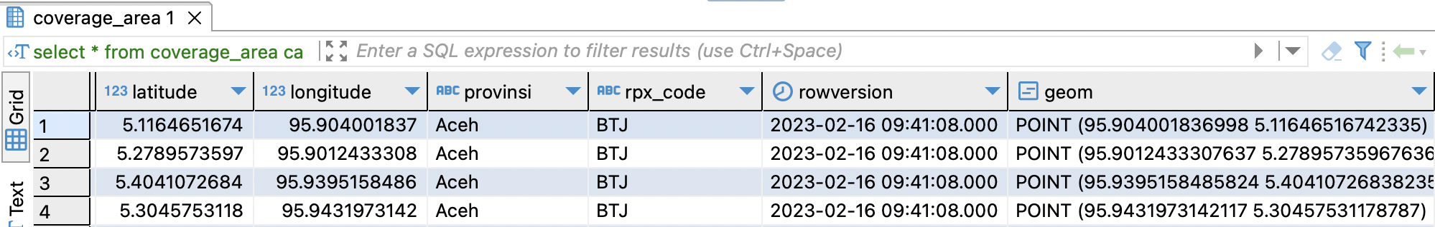
5. Update value for new column using this query
UPDATE coverage_area set geom = st_setsrid(st_makepoint(longitude, latitude), 4326) where geom is null;
6. Add index for new column
CREATE INDEX idx_geom_coverage_area ON coverage_area USING gist (geom);
7. Explore all postGIS spatial function.
Notes:
WKT (well known text)

Slide 9
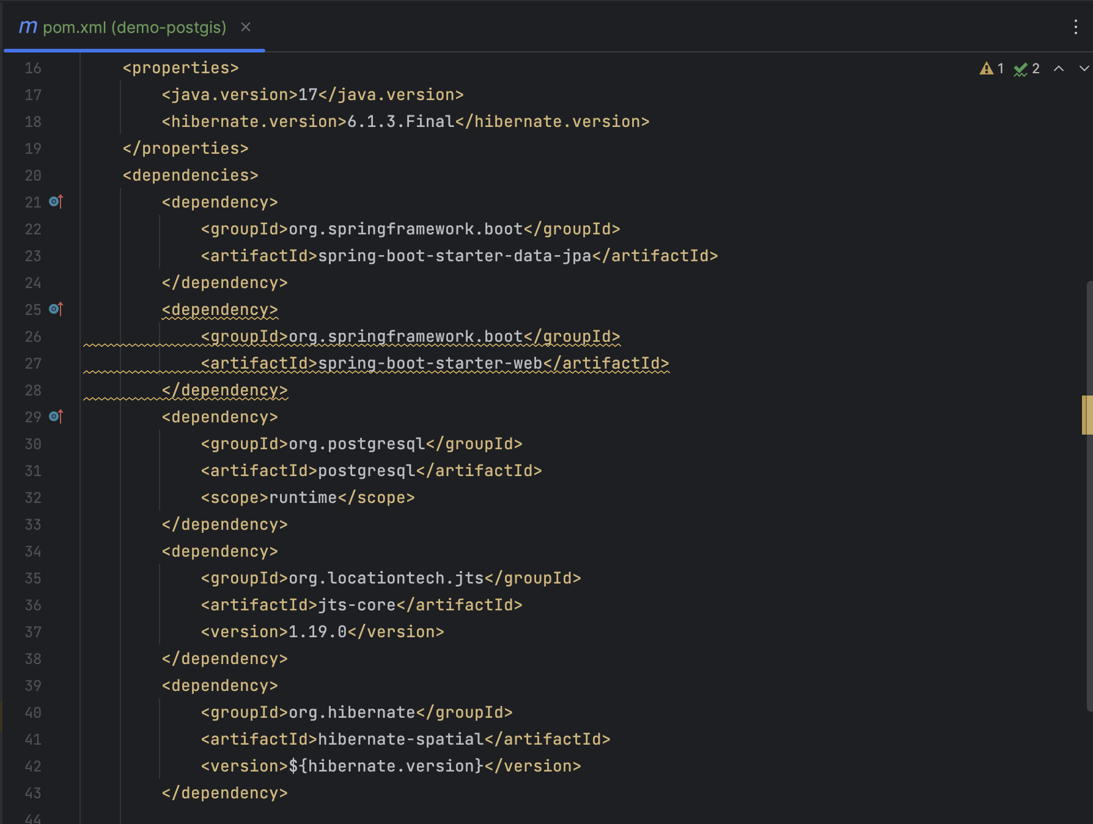
Java Spring Boot side
Add dependencies
For spatial variable
For spatial function

Slide 10
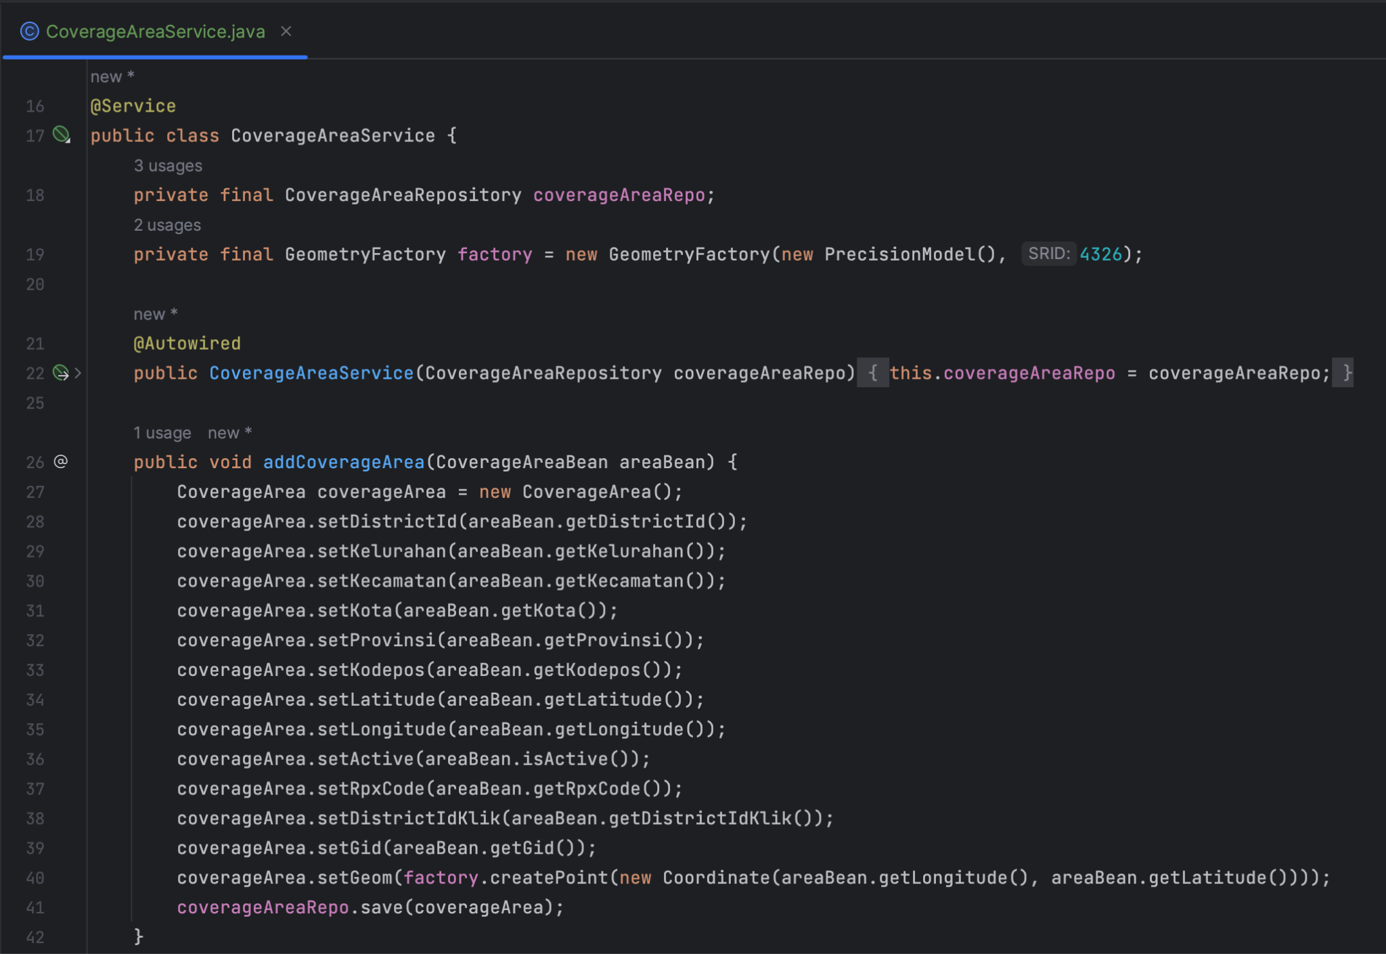
2. Configure to store new data

Slide 11
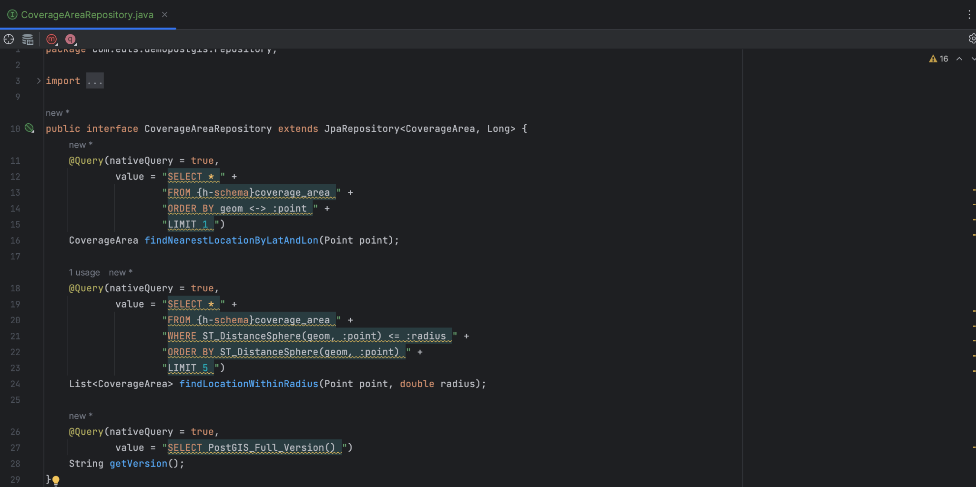
3. Configure query in repository class

Slide 12
Study Case:
Find nearest location (Haversine Formula vs PostGIS)
Given latitude = -6.216854 and longitude = 106.812187
Haversine formula
SELECT * FROM coverage_area
ORDER BY (6371 * acos(cos(radians(-6.216854)) * cos(radians(latitude)) * cos(radians(longitude) - radians(106.812187)) + sin(radians(-6.216854)) * sin(radians(latitude))))
LIMIT 1;
PostGIS function
SELECT * FROM coverage_area ca
ORDER BY geom <-> ST_GeogFromText('POINT(106.812187 -6.216854)')
LIMIT 1;

Slide 13
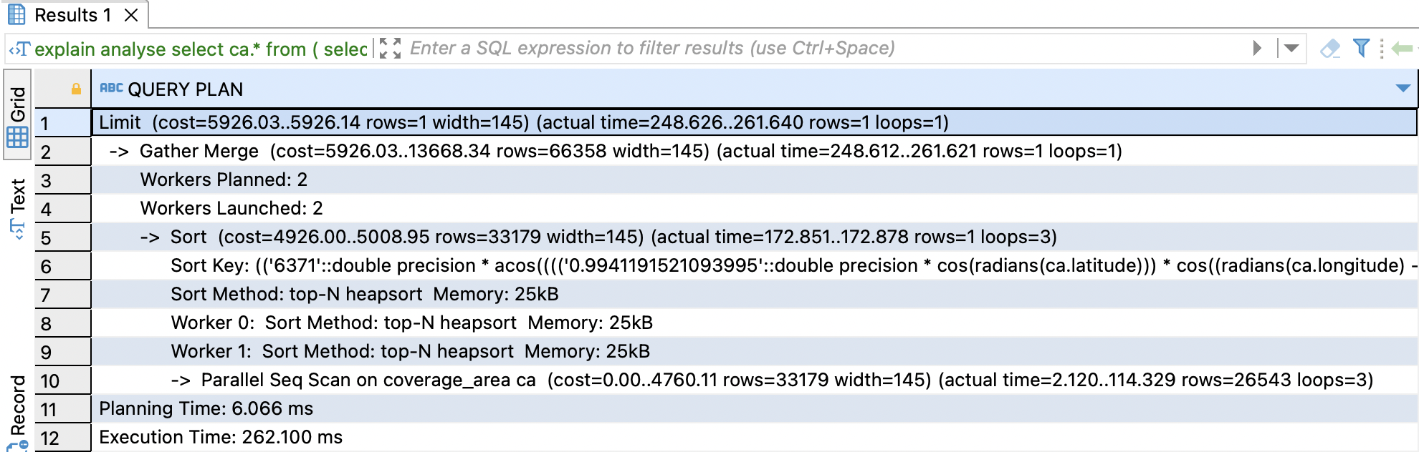
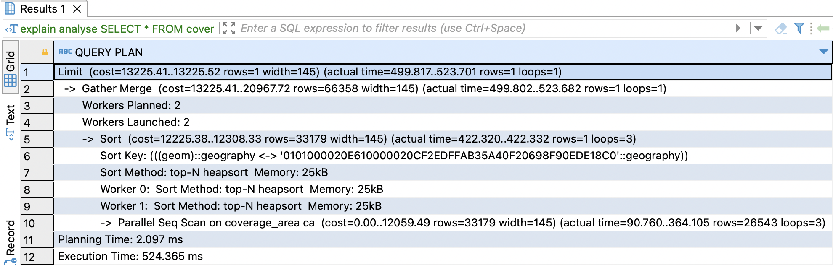
Analyze the query result
Haversine formula
PostGIS function

Slide 14


Phone
(+62)895 1597 5964
Email
julinaromits@gmail.com
THANK YOU!
julinar
Julinar Julinar

